Slide 1
Database System
Lecture 2
Introduction
Alina Arshad
alina.arshad@nu.edu.pk
Basement 2 Room#4

Slide 2
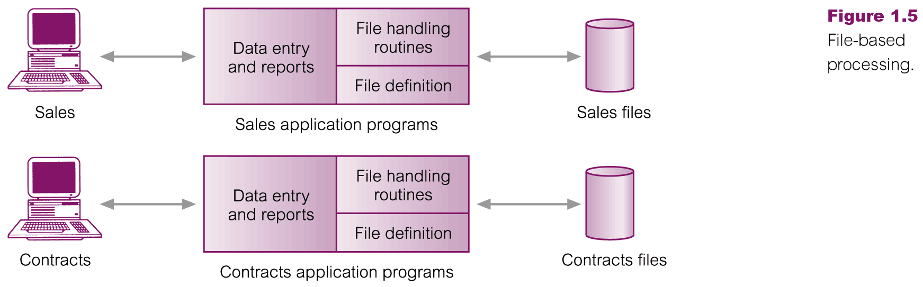
Files Base Systems

Slide 3
Limitations of File-Based Approach
Separation and isolation of data
Each program maintains its own set of data.
Users of one program may be unaware of potentially useful data held by other programs.
Duplication of data
Same data is held by different programs.
Wasted space and potentially different values and/or different formats for the same item.

Slide 4
Limitations of File-Based Approach
Data dependence
File structure is defined in the program code.
For example, increasing the size of the field.
Incompatible file formats
Programs are written in different languages, and so cannot easily access each other’s files.
Fixed Queries of application programs
Programs are written to satisfy particular functions.
Any new requirement needs a new program.

Slide 5
Files vs Databases
Program data dependence.
No Data Security.
Data Inconsistency and lack of data Integrity.
Not Flexible.
Separation and isolation of data
Duplication of data.
Fixed queries
Notes:
Separation and isolation of data
Duplication of data
Data dependence
Incompatible file formats
From the end-user’s point of view, file-based systems were a great improvement over manual systems. Consequently, the requirement for new or modified queries grew.
Fixed queries
However, file-based systems are very dependent upon the application developer, who has to write any queries or reports that are required. As a result, two things happened. In some organizations, the type of query or report that could be produced was fixed. There was no facility for asking unplanned (that is, spur-ofthe-moment or ad hoc) queries either about the data itself or about which types of data were available. In other organizations, there was a proliferation of files and application programs. Eventually, this reached a point where the DP Department, with its existing resources, could not handle all the work. This put tremendous pressure on the DP staff, resulting in programs that were inadequate or inefficient in meeting the demands of the users, limited documentation, and difficult maintenance. Often, certain types of functionality were omitted: • There was no provision for security or integrity. • Recovery, in the event of a hardware or software failure, was limited or nonexistent. • Access to the files was restricted to one user at a time—there was no provision for shared access by staff in the same department. In either case, the outcome was unacceptable. Another solution was required.

Slide 6
Database Management System (DBMS)
Computerized system that enables users to create and maintain a database.
For example: MySQL, Oracle, etc. are a very popular commercial database which is used in different applications.
General-purpose software system: facilitates the processes of defining, constructing, manipulating, and sharing databases among various users and applications.

Slide 7
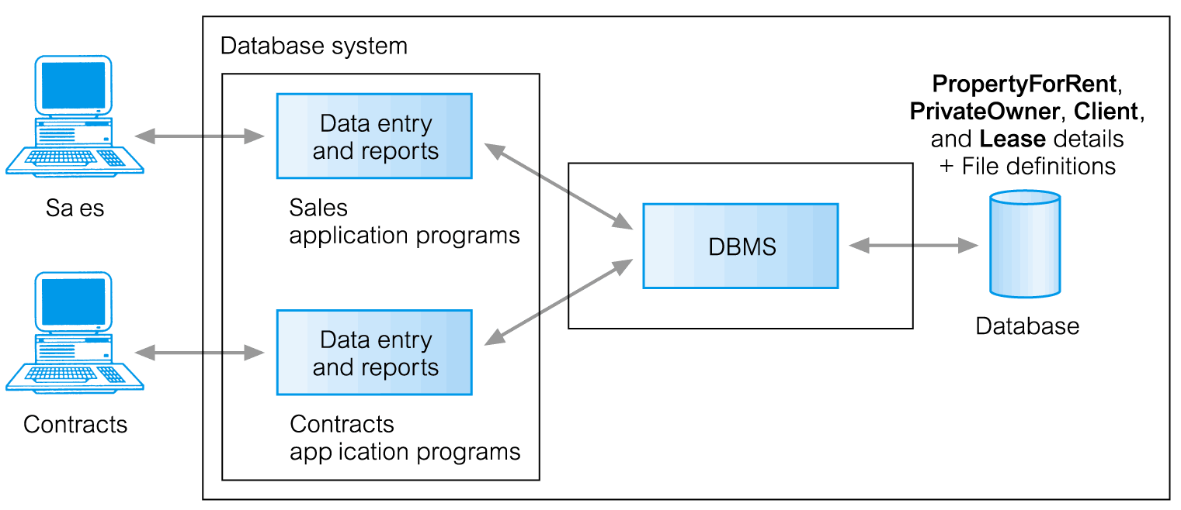
Database Management System (DBMS)

Slide 8
DBMS Functionality
Define a database : in terms of data types, structures and constraints
Construct or Load: storing data on a secondary storage medium.
Manipulating the database : querying, generating reports, insertions, deletions and modifications to its content
Concurrent Processing and Sharing by a set of users and programs – yet, keeping all data valid and consistent.

Slide 9
DBMS Functionality
An application program accesses the database by sending queries for data to the DBMS.
Query: to retrieve and manipulate data.
Transaction: that reads and write data into the database.
Other important functions provided by the DBMS include:
Protection against hardware or software malfunction and unauthorized or malicious access.
Maintenance: database can be maintained and updated for a long period of time.
Notes:
An application program accesses the database by sending queries or requests for data to the DBMS. A query2 typically causes some data to be retrieved; a transaction may cause some data to be read and some data to be written into the database.
Other important functions provided by the DBMS include protecting the database and maintaining it over a long period of time.
Protection includes system protection against hardware or software malfunction (or crashes) and security protection against unauthorized or malicious access.
A typical large database may have a life cycle of many years, so the DBMS must be able to maintain the database system by allowing the system to evolve as requirements change over time.
It is not absolutely necessary to use general-purpose DBMS software to implement a computerized database. It is possible to write a customized set of programs to create and maintain the database, in effect creating a special-purpose DBMS software for a specific application, such as airlines reservations. In either case—whether we use a general-purpose DBMS or not—a considerable amount of complex software is deployed. In fact, most DBMSs are very complex software systems.
Protection includes system protection
against hardware or software malfunction (or crashes) and security protection
against unauthorized or malicious access.

Slide 10
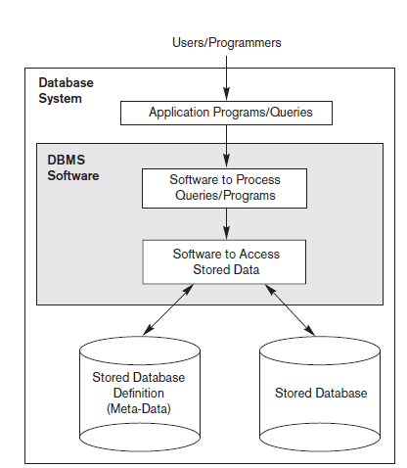
Simplified Database System Environment

Slide 11
UNIVERSITY Database Example
Some mini-world entities:
Students
Courses
Sections (of courses)
Departments
Instructors
Some mini-world relationships:
Sections are of specific Courses
Students take Sections
Courses have Prerequisite Courses
Instructors teach Sections
Courses are offered by departments
Students major in Departments

Slide 12
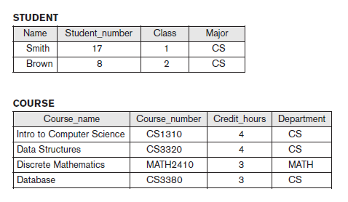
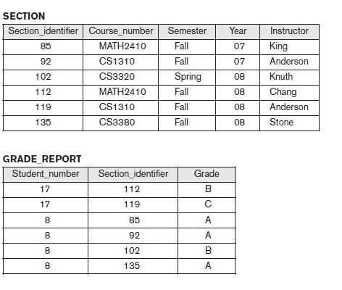
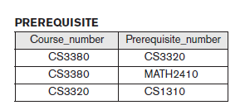
UNIVERSITY Database Example
Figure 1.2 A database that stores student and course information
Notes:
The database is organized as five files, each of which stores data records of the same type.

Slide 13
Characteristics of Database Approach
Self-describing nature of a database system.
Database system contains not only the database itself but a complete definition or description of the database structure and constraints.
This definition is stored in the DBMS catalog.
Structure of each file
Type
Storage
Format of each data item
Various constraints on the data.
The information stored in the catalog is called meta-data, and it describes the structure of the primary database.
Notes:
The catalog is used by the DBMS software and also by database users who need information about the database structure. A general-purpose DBMS software package is not written for a specific database application. Therefore, it must refer to the catalog to know the structure of the files in a specific database, such as the type and format of data it will access. The DBMS software must work equally well with any number of database applications—for example, a university database, a banking database, or a company database—as long as the database definition is stored in the catalog.
In traditional file processing, data definition is typically part of the application programs themselves. Hence, these programs are constrained to work with only one specific database, whose structure is declared in the application programs. For example, an application program written in C++ may have struct or class declarations. Whereas file-processing software can access only specific databases, DBMS software can access diverse databases by extracting the database definitions from the catalog and using these definitions.
For the example shown in Figure 1.2, the DBMS catalog will store the definitions of all the files shown. Figure 1.3 shows some entries in a database catalog. Whenever a request is made to access, say, the Name of a STUDENT record, the DBMS software refers to the catalog to determine the structure of the STUDENT file and the position and size of the Name data item within a STUDENT record. By contrast, in a typical file-processing application, the file structure and, in the extreme case, the exact location of Name within a STUDENT record are already coded within each program that accesses this data item.

Slide 14
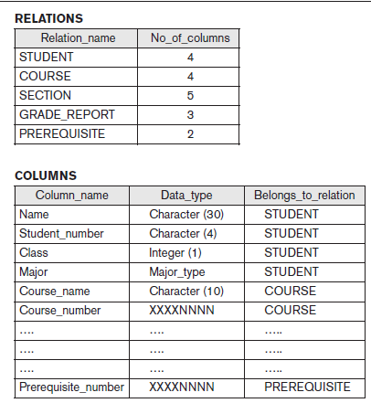
Example of a DATABASE CATALOG
Figure 1.3 An example of a database catalog for the database in Figure 1.2.

Slide 15
Characteristics of Database Approach
Data abstraction (insulation between program & Data)
A data model is used to hide storage details and present the users with a conceptual view of the database.
Programs refer to the data model constructs rather than data storage details
Support of multiple views of the data
A database typically has many types of users, each of whom may require a different view of the database.
View: subset of the database or it may contain virtual data that is derived from the database files but is not explicitly stored.
Notes:
In traditional file processing, the structure of data files is embedded in the application programs, so any changes to the structure of a file may require changing all programs that access that file. By contrast, DBMS access programs do not require such changes in most cases. The structure of data files is stored in the DBMS catalog separately from the access programs. We call this property program-data independence.
For example, a file access program may be written in such a way that it can access only STUDENT records of the structure shown in Figure 1.4. If we want to add another piece of data to each STUDENT record, say the Birth_date, such a program will no longer work and must be changed. By contrast, in a DBMS environment, we only need to change the description of STUDENT records in the catalog (Figure 1.3) to reflect the inclusion of the new data item Birth_date; no programs are changed. The next time a DBMS program refers to the catalog, the new structure of STUDENT records will be accessed and used.
In some types of database systems, such as object-oriented and object-relational systems users can define operations on data as part of the database definitions. An operation (also called a function or method) is specified in two parts. The interface (or signature) of an operation includes the operation name and the data types of its arguments (or parameters). The implementation (or method) of the operation is specified separately and can be changed without affecting the interface. User application programs can operate on the data by invoking these operations through their names and arguments, regardless of how the operations are implemented. This may be termed program-operation independence. The characteristic that allows program-data independence and program-operation independence is called data abstraction.
A DBMS provides users with a conceptual representation of data that does not include many of the details of how the data is stored or how the operations are implemented. Informally, a data model is a type of data abstraction that is used to provide this conceptual representation. The data model uses logical concepts, such as objects, their properties, and their interrelationships, that may be easier for most users to understand than computer storage concepts. Hence, the data model hides storage and implementation details that are not of interest to most database users.

Slide 16
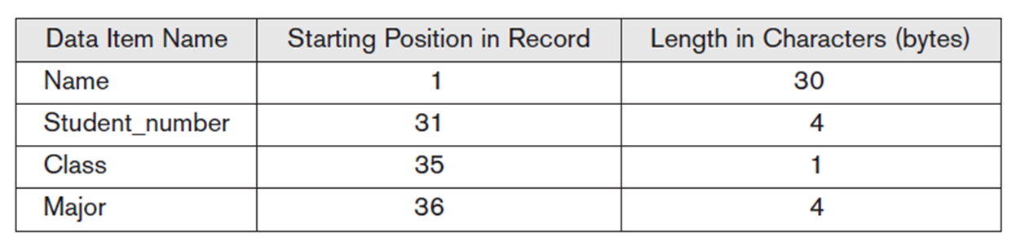
Internal storage format for a STUDENT record, based on the database catalog
Figure 1.4 Internal storage format for a STUDENT record, based on the database catalog in Figure 1.3.
Notes:
Looking at the example in Figures 1.2 and 1.3, the internal implementation of the STUDENT file may be defined by its record length—the number of characters (bytes) in each record—and each data item may be specified by its starting byte within a record and its length in bytes. The STUDENT record would thus be represented as shown in Figure 1.4. But a typical database user is not concerned with the location of each data item within a record or its length; rather, the user is concerned that when a reference is made to Name of STUDENT, the correct value is returned. A conceptual representation of the STUDENT records is shown in Figure 1.2. Many other details of file storage organization—such as the access paths specified on a
file—can be hidden from database users by the DBMS.
In the database approach, the detailed structure and organization of each file are stored in the catalog. Database users and application programs refer to the conceptual representation of the files, and the DBMS extracts the details of file storage from the catalog when these are needed by the DBMS file access modules. Many data models can be used to provide this data abstraction to database users.
. In object-oriented and object-relational databases, the abstraction process includes not only the data structure but also the operations on the data. These operations provide an abstraction of miniworld activities commonly understood by the users. For example, an operation CALCULATE_GPA can be applied to a STUDENT object to calculate the grade point average. Such operations can be invoked by the user queries or application programs without having to know the details of how the operations are implemented.

Slide 17
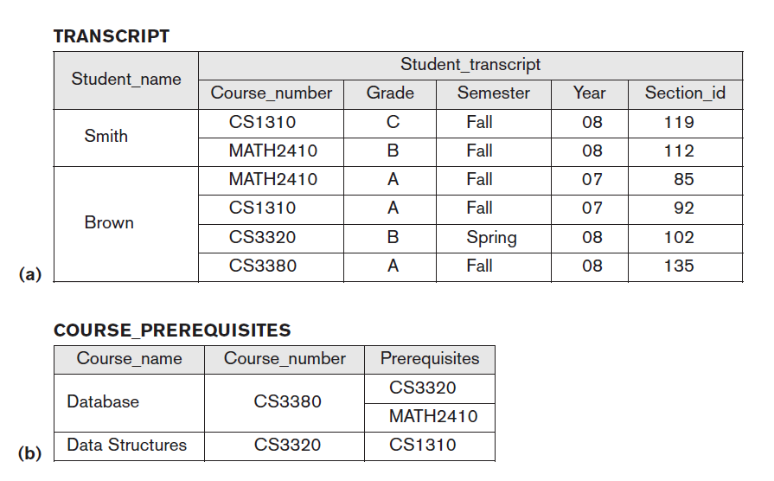
Characteristics of Database Approach
Two views derived from the database in Figure
(a) The TRANSCRIPT view.
(b) The COURSE_PREREQUISITES view.

Slide 18
Characteristics of Database Approach
Sharing of data and multiuser transaction processing.
Multiple users to access the database at the same time.
Concurrency control: ensures that several users trying to update or retrieve the same data in so controlled manner.
i.e., Airline Reservation
A fundamental role of multiuser DBMS software is to ensure that concurrent transactions operate correctly and efficiently.
OLTP (Online Transaction Processing) is a major part of database applications. This allows hundreds of concurrent transactions to execute per second.
Notes:
For example, when several reservation agents try to assign a seat on an airline flight, the DBMS should ensure that each seat can be accessed by only one agent at a time for assignment to a passenger. These types of applications are generally called online transaction processing (OLTP) applications.
A fundamental role of multiuser DBMS software is to ensure that concurrent transactions operate correctly and efficiently. The concept of a transaction has become central to many database applications. A transaction is an executing program or process that includes one or more database accesses, such as reading or updating of database records. Each transaction is supposed to execute a logically correct database access if executed in its entirety without interference from other transactions.
The DBMS must enforce several transaction properties. The isolation property ensures that each transaction appears to execute in isolation from other transactions, even though hundreds of transactions may be executing concurrently. The atomicity property ensures that either all the database operations in a transaction are executed or none are

Slide 19
Any question????

